Slide 1

Project 3 - Image tagging and road object detection
1

Slide 2
01
Problem Framing
Image Tagging and Road Object Detection
Related Work & Summary of Research Papers
State-of-the-art Object Detection Models and Datasets
02
System Description
Implementation of state-of-the-art models: YOLO models
03
Experimental Results
Understanding and comparison of results with YOLO3
04
Conclusion
Conclusion and Future Work
05
2

Slide 3

Motivation & Problem Statement : AUTONOMOUS DRIVING
Object detection and Segmentation is one of the most challenging problems in Computer Vision technologies and active research topic in Deep Learning.
Requirement of Autonomous Driving: Road Object Detection.
Accurate and real-time Object Detection algorithms needed.
Aim to develop a system/model that detects and tag the multiple objects efficiently using deep learning algorithms.
Detect object tagging in the multiple frames of video / image / video by applying the trained model.
5

Slide 4
Summary & Insights of Model Papers
Initial Reading -
Computer vision is an interdisciplinary field that has been gaining huge amounts of traction in the recent years(since CNN) and self-driving cars have taken centre stage.
Object Detection is one of the integral part of Computer Vision field.
Can we solve the detection / object detection by building a standard convolutional network followed by FC Layer ??
NO, the length of the output layer is variable — not constant
A naive approach to solve this problem is -
take different regions of interest from the image
use a CNN to classify the presence of the object within the region.
Then what’s the problem with this solution? Any other improvements / solutions ?
the objects of interest might have different spatial locations within the image and different aspect ratios.
would have to select a huge number of regions and could computationally blow up.
Hence algorithms like R-CNN, YOLO have been developed.
Continued...
5

Slide 5
R-CNN
Proposed a method where we use Selective Search to extract just 2000 regions from the image, called them as region proposals.
2000 candidate region suggestions are squared and input into a CNN , which outputs a 4096-dimensional feature vector.
SVM Classifier is used to classify the object's presence within region proposal and 4 offset values to increase the precision of the bounding box.
Challenged / Issues with R-CNN
a huge amount of time to train the network to classify 2000 region proposals per image.
Selective Search algorithm is a fixed algorithm, no learning happening at this stage.
Leads to the generation of bad candidate region proposals.
It cannot be implemented real time as it takes around 47 seconds for each test image.
Continued...
5

Slide 6
Fast R-CNN ( same as R-CNN but with improvements )
Pass the input image to the CNN to build a convolutional feature map, instead of region recommendations.
(1) Select the region of proposals from the convolutional feature map,
(2) warp them into squares,
(3) then reshape them into a fixed size using a RoI pooling layer so that they can be fed into a FC layer.
Use a softmax layer to predict the class of the proposed region & offset values for the bounding box.
Notable points:
don’t have to feed 2000 region proposals to the convolutional neural network every time.
the convolution operation is done only once per image and a feature map is generated from it.
Performance is poor when you are including region proposals during testing time.
Faster R-CNN
eliminates the selective search algorithm and lets the network learn the region proposals.
A separate network is used to predict the region proposals.
Continued...
5

Slide 7
Basic Working of YOLO Object Detector Models
Recall is the ratio of true positives to total positive prediction(correct or incorrect).
Precision is the ratio of true positives to the ground truth positives(total correct predictions).
The mean of all average precision is called mean average precisions(mAP).
The architecture of all the YOLO models have a similar theme of components -
1. Backbone: A convolutional neural network that accumulates and produces visual features with different shapes and sizes.
Classification models like ResNet, VGG, and EfficientNet are used as feature extractors.
2. Neck: A set of layers that integrate and blend characteristics before passing them on to the prediction layer. Ex: FPN
3. Head: Takes in features from the neck along with the bounding box predictions.
Performs classification along with regression on the features & bounding box coordinates for detection process.
Outputs 4 values, generally x,y coordinate along with width and height.
Continued...
5

Slide 8
YOLOv1 – The Beginning
The first YOLO model was introduced by Joseph Redmon et all in their 2015 paper titled “You Only Look Once: Unified, Real-Time Object Detection”.
RCNN family of models were accurate but were relatively slow because it was a multi-step process.
YOLO was created to perform object detection in just a single stage.
Technical Improvements
Unified detection technique / single feed neural network.
The model divides an incoming image into numerous grids and calculates the probability of an object resides inside that grid.
The algorithm groups nearby high-value probability grids as a single object.
Low-value predictions are discarded using a technique called Non-Max Suppression(NMS).
The model is trained in a fashion where the center of each object detected is compared with the ground truth.
5

Slide 9
YOLOv2 – Better, Faster, Stronger
YOLOv2 was released by Joseph Redmon and Ali Farhadi in 2016 in their paper titled “YOLO9000:Better, Faster, Stronger”.
The 9000 signified that YOLOv2 was able to detect over 9000 categories of objects.
Technical Improvements
YOLOv2 version introduced the concept of anchor boxes.
Anchor boxes are nothing but predefined areas for an image that illustrates the idealized position of the objects to be detected.
Calculate the ratio of overlap over union (IoU) of the predicted bounding box and the pre-defined anchor box.
The IoU value acts as a threshold to decide whether the probability of the detected object is sufficient to make a prediction or not.
YOLO algorithm examines the training data and performs clustering on it (dimension clusters) to enhance the accuracy.
5

Slide 10
YOLOv2 – Better, Faster, Stronger
Additional Technical Improvements
YOLOv2 model is randomly resized throughout the training process (this is called multi-scale training) for dapting different aspect ratios.
YOLOv2 model was trained on a combination of the COCO dataset (80 classes with bounding boxes) and the ImageNet dataset (22k classes without bounding boxes).
When the model processes an image with labels the detection and classification error is calculated.
Whereas when the model sees a label-less image it backpropagates the classification error only. (WordTree structure)
Inference speeds of up to 200 FPS and mAP of 75.3 were achieved using a classification network architecture called darknet19 (the backbone of YOLO).
5

Slide 11
YOLOv3: An Incremental Improvement
In 2018, Joseph Redmon and Ali Farhadi introduced the third version of YOLOv3 in their paper “YOLOv3: An Incremental Improvement”.
YOLOv3 consisted of 75 convolutional layers without using fully connected or pooling layers which greatly reduced the model size and weight.
A feature pyramid network is a feature extractor that extracts different types/forms/sizes of features for a single image. It concatenates all the features so that the model can learn local and general features.
As the backbone, the YOLOv3 model uses the Darknet53 architecture.
5

Slide 12
Deep Learning Model Life Cycle
5

Slide 13
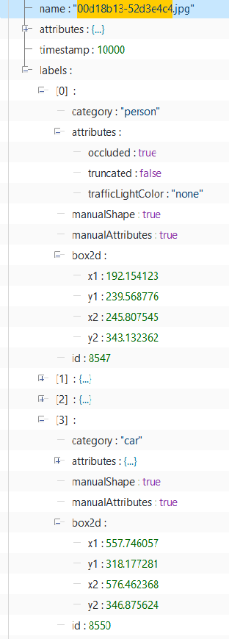
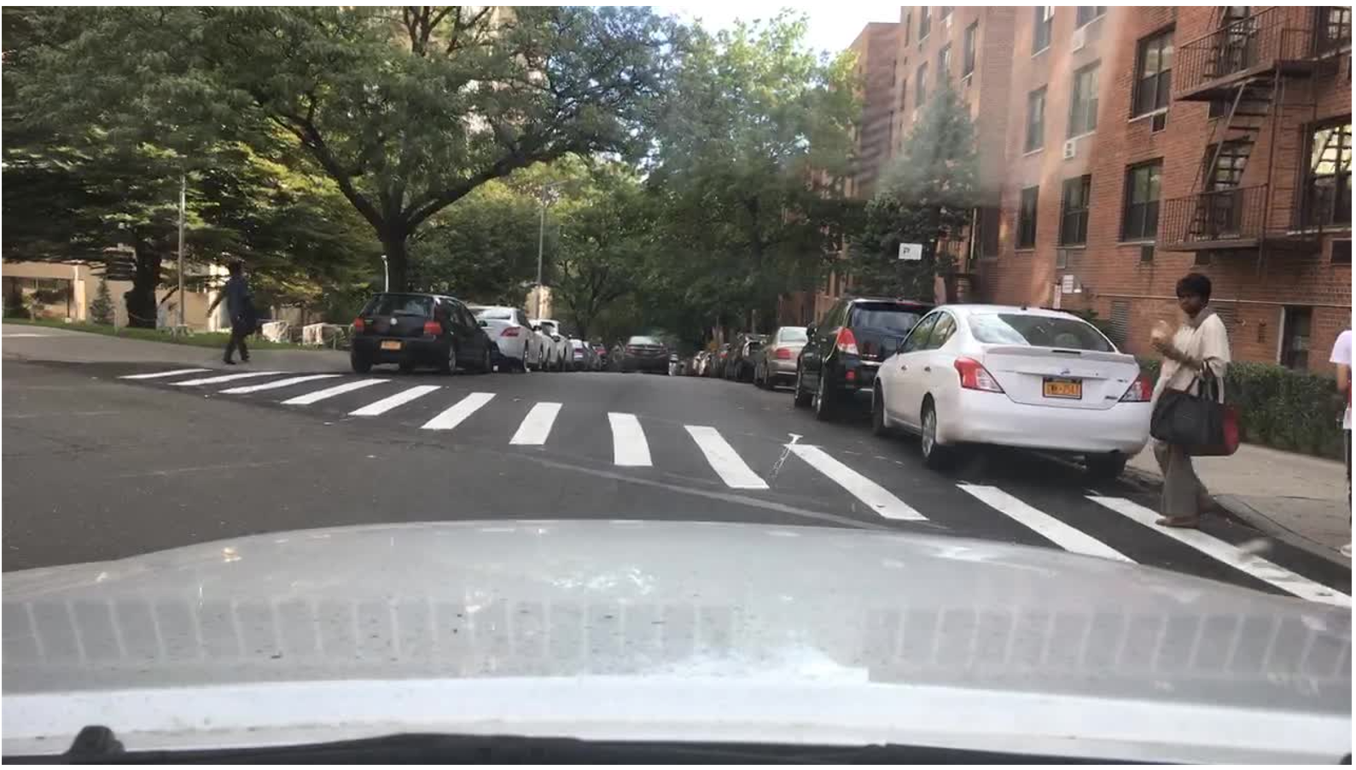
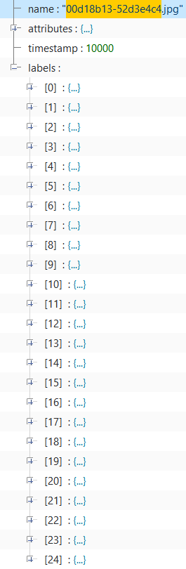
Data [Sourcing, Labelling & Versioning]: The BDD100K Dataset
100K Images : They are used for object detection, drivable area, lane marking.
The images in this package are the frames at the 10th second in the videos.
The split of train, validation, and test sets are the same with the whole video set.
- bdd100k - images - 100k - train - val - test
5

Slide 14
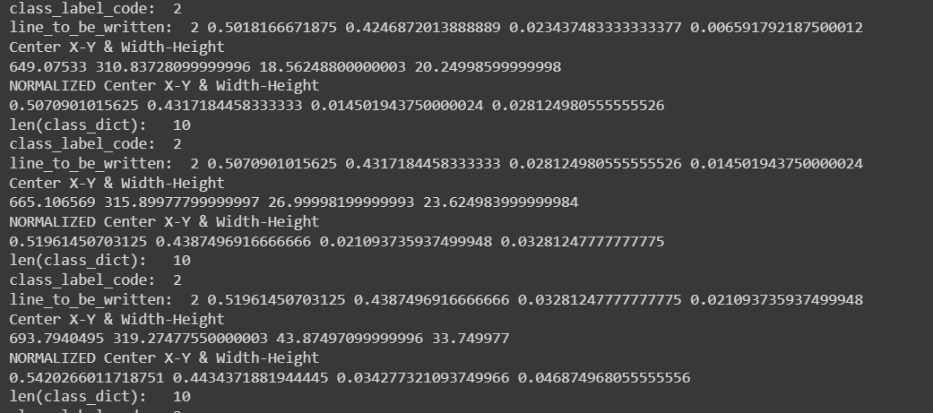
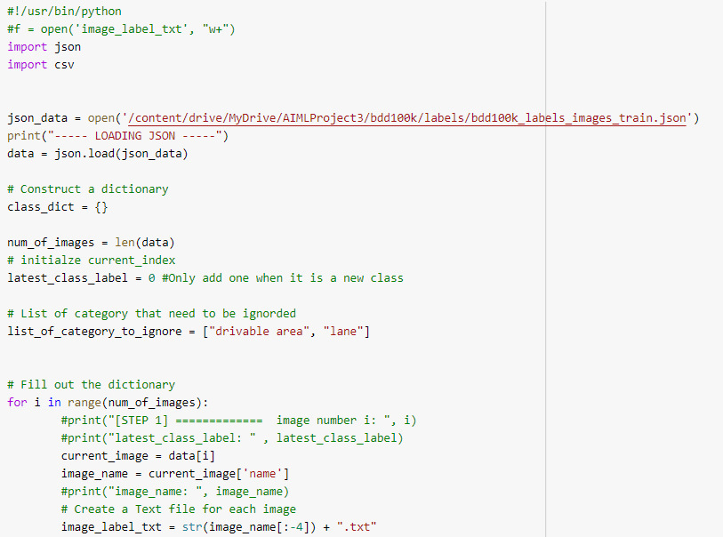
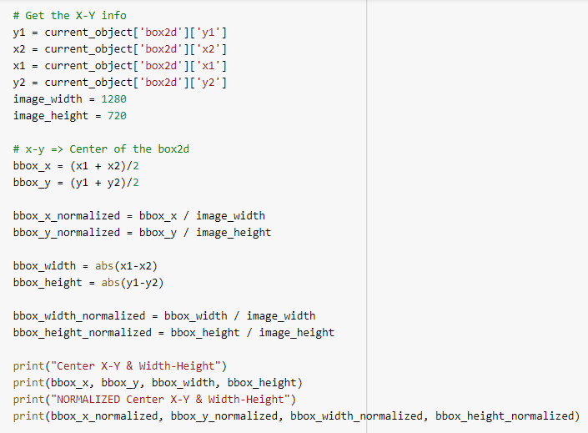
Data [Sourcing, Labelling & Versioning]: The BDD100K Dataset
To convert annotations into YOLO format:
Labelme
Roboflow
VOTT
Converted all the Images into YOLO format using a piece of Python code and result can observe below:
But all these techniques consumes more time and requires manual effort for annotations.
5

Slide 15
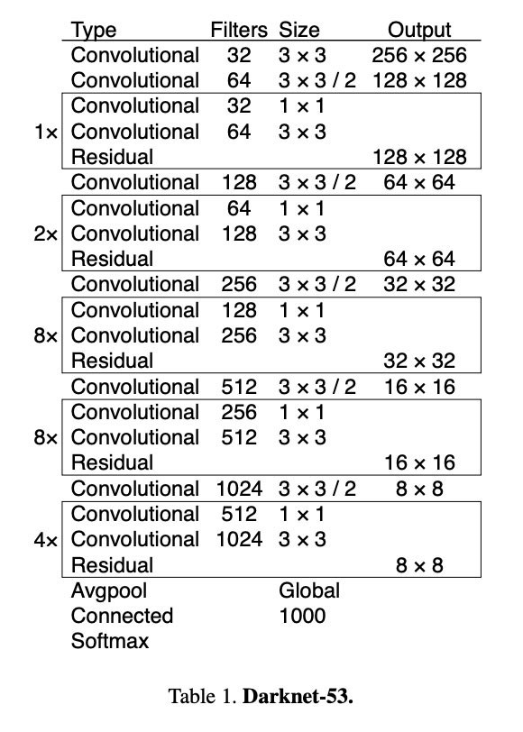
Model Architecture at High Level
Layer's Structure
53 CNNs layers (Darknet –53) stacked
53 more layers producing
106 layers of YOLO V3
Darknet Framework
Loads 106 Layers
Detections at layers : 82, 94 and 106
Improvements & Essential Elements
Residual Blocks
Skip Connections
Up-Sampling
CNN Layers followed by
Batch Normalization
Leaky ReLU
YOLO V3
No Pooling layers ,Convolutional Layers instead
Prevents Loss of low-level features
Ability to detect small objects
Input Shape & Network's Input - ( n, 416, 416, 3)
5

Slide 16
Yolov3 Network Architecture Deep Dive
Yolo V3 is an improvement over the previous two YOLO versions.
Yovo V3 model features multi-scale detection, a strong feature extraction network and changes in loss function.
Network Architecture divided into two components -
Feature Extractor
Feature Detector (Multi-Scale Detector).
Feature Extractor
Earlier YOLO versions have used Darknet-19 and YOLO v2 added 11 more layers to Darknet-19 to make it a 30-layer architecture.
Still, the algorithm faced a challenge while detecting small objects due to downsampling the input image.
YOLO v3 becomes a better architecture where the feature extractor used was a hybrid of YOLO v2 , Darknet-53 ( Pre-trainined Network) , and Residual Networks (ResNet).
The Darknet-53 network built with consecutive 3x3 and 1x1 convolution layers followed by a skip connection.
5

Slide 17
The 53 layers of the darknet are further stacked with 53 more layers for
the detection head.
YOLO v3 a total of a 106 layer fully convolutional underlying architecture.
Classification - The Average pool layer, 1000 fully connected layers, and a SoftMax activation function would be added.
What is our aim here with YOLOv3 ?
Detect the classes along with the locations
Hence appending a detection head to the extractor. ( Multi-scale detection head).
We would need to extract features at many scales because the detection head is a multi-scale detection head.
5

Slide 18
Multi-scale Feature Extractor for a 416x416 image.
A stride of a layer is defined as the ratio by which it downsamples the input, and hence the three scales in our case would be 52x52, 26x26, and 13x13.
13x13 used for larger objects and 26x26 and 52x52 would be used for medium and smaller objects.
5

Slide 19
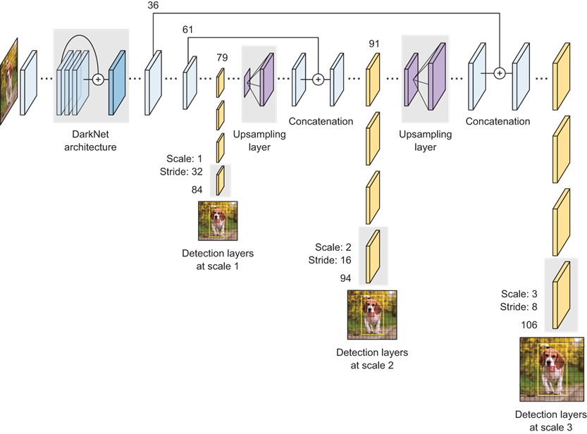
Multi-scale detector
Application of 1x1 detection kernels on feature maps of three different sizes at three distinct locations as shown in below network architecture. The shape of the kernel is 1x1x(B*(5+C)).
Complete Network Architecture
5

Slide 20
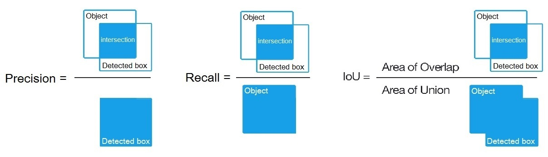
Working of YOLO v3
YOLO v3 network aims to predict bounding boxes of each object along with the probability of the class which the object belongs to.
Non-Maximum Suppression
The expected output may contain numerous bounding boxes for the same object because the centroid is same.
NMS method ignore the bounding boxes whose confidence is below the threshold.
NMS Implementation:
1) Arrange all the confidences of the bounding boxes in descending order.
2) Choose the highest score as the most appropriate one for the object.
3) Find all the other boxes with high Intersection over Union (IoU) with the bounding box with maximum confidence and eliminate all the remaining.
5

Slide 21
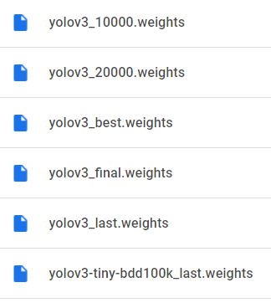
YOLO v3 Model Training
Create yolo3 and training folders in your google drive.
Mount drive, link your folder, and navigate to the yolov3 folder
Clone the Darknet git repository
Create & upload the files needed for training a custom detector
Labeled Custom Dataset
Custom cfg file changes
bdd100k.data and bdd100k.names files
preprocessing script (to create train.txt and test.txt files for training)
Make changes in the makefile to enable OPENCV and GPU
Run make command to build darknet
Copy all the files “data.zip”, “yolov3-tiny-bdd100k.cfg / yolov3.cfg”, “bdd100k.data”, “bdd100k.names” from the yolov3 folder to the darknet dir.
Ensure to keep the train.txt & test.txt files generated as part of data preprocessing.
Download the pre-trained YOLOv3 weights from AlexyAB
Train the detector
Check performance by looking at the training chart.
5

Slide 22
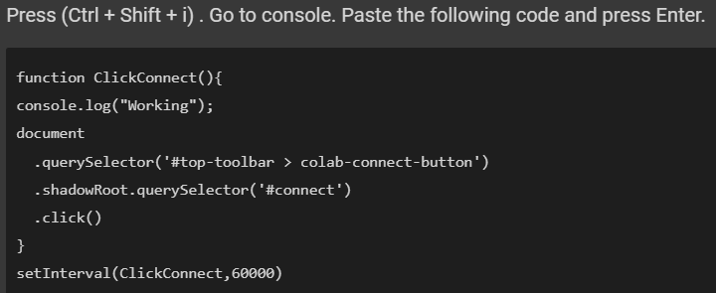
Generic Challenges during Model Training
Scaling Hardware - Colab VM has been scaled up / upgraded to Colab Pro for more compute power.
Training is stopped due to frequent disconections , need to monitor for longer hours
If you get disconnected or lose your session for some reason you have to run again to mount the drive, edit makefile and build darknet every single time, otherwise the darknet executable will not work.
Google drive storage is very limited to store huge datasets, weights files , custom training weights files etc.
Learnings from Model Training
1) Finding hack for Auto-Click to avoid being kicked off Colab VM.
2) Monitoring training chart during training for performance
3) Understand the darknet model training and its weights files based on
the max_batches and steps.
4) Checking the mAP value for all the saved weights to see which gives the best results.
5) Run custom detector on test / unseen images by changing with different threshold values
5

Slide 23
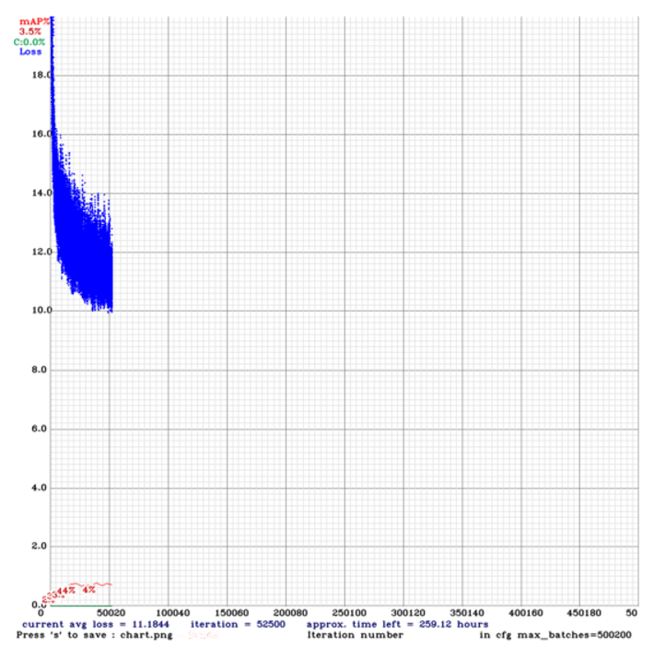
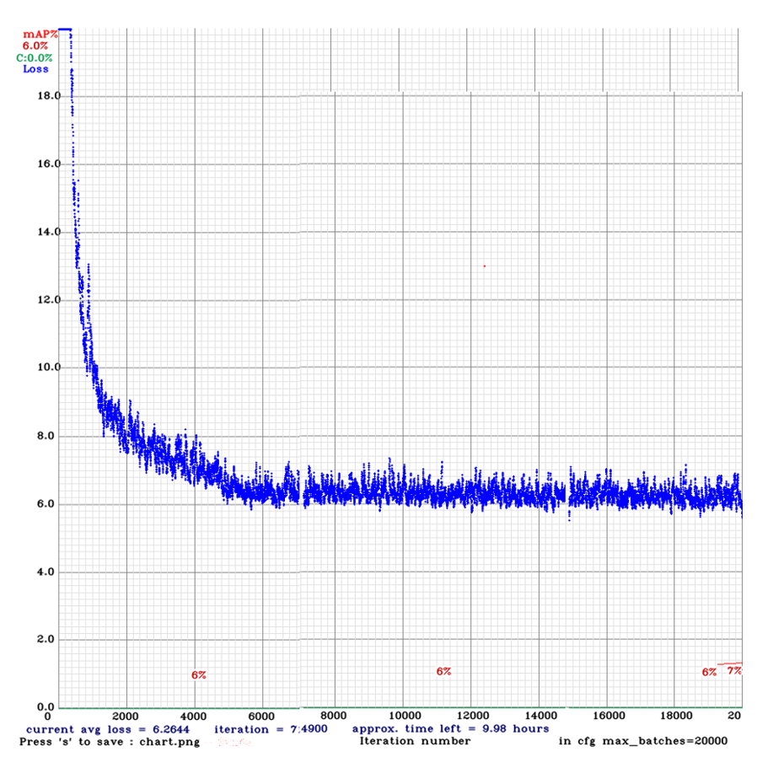
Model Evaluation - Training Performance Chart
YOLOv3-Tiny
YOLOv3
5

Slide 24
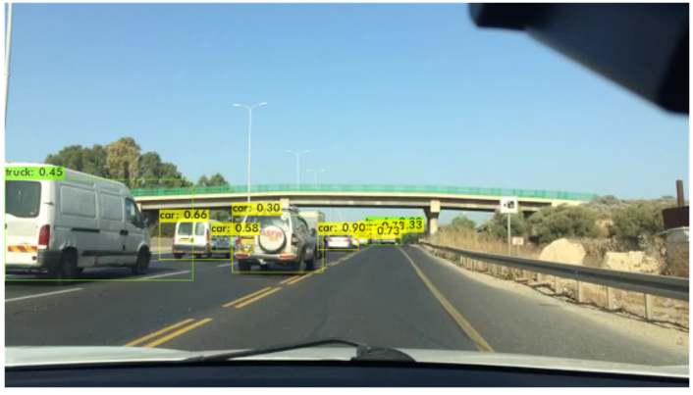
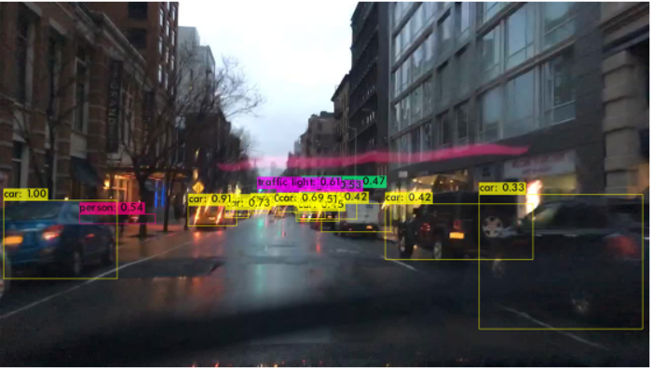
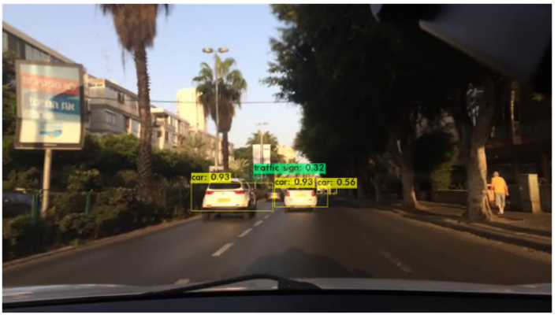
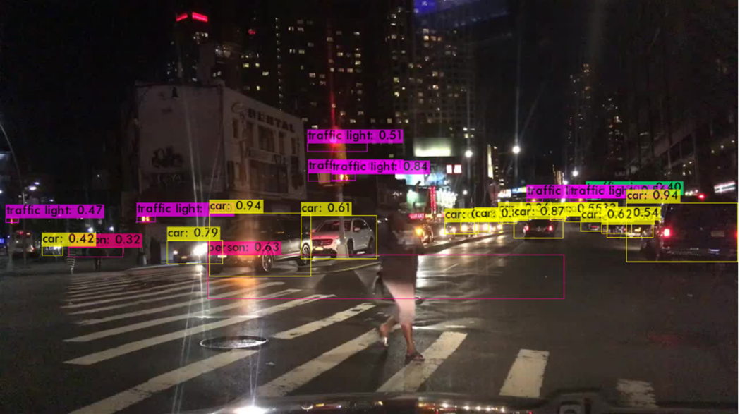
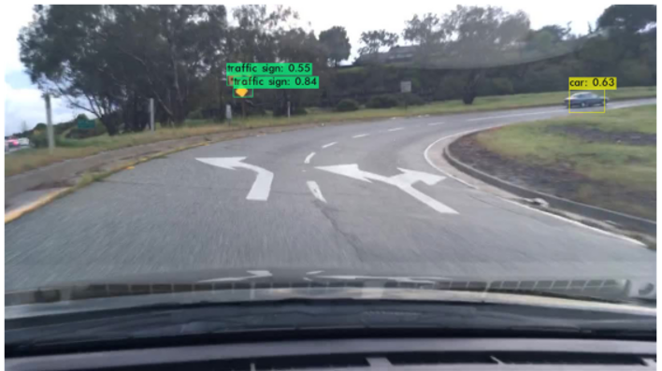
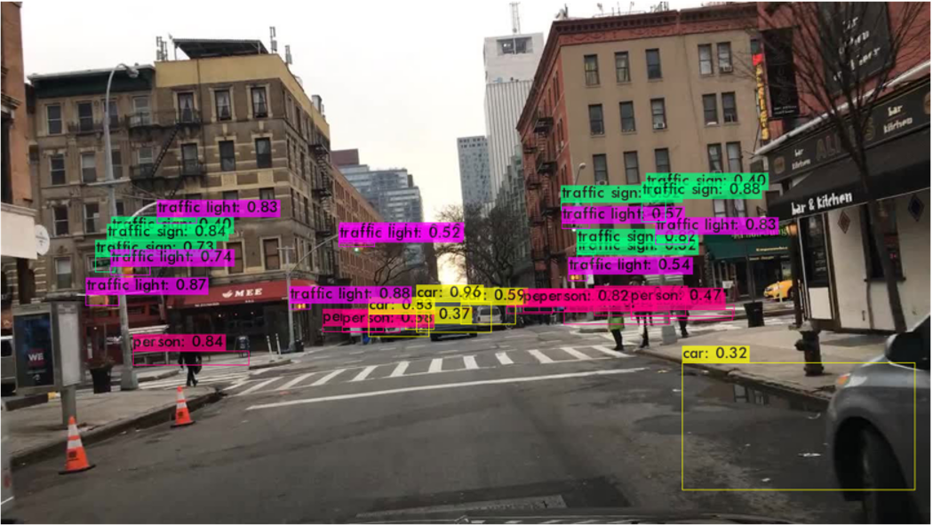
Custom Object Detection Output
5

Slide 25
Model Evaluation / Performance Metrics
There are 3 ways for measuring the performance of YOLOv3
IOU Score - choose some threshold value to classify the detection is correct or not
Average Precision - Compute average precision for each object in the image
mAP Score - the mean of all the average precision values
5

Slide 26
Loss Function
YOLO uses sum-squared error between the predictions and the ground truth to calculate loss.
The loss function composes of:
the localization loss (errors between the predicted boundary box and the ground truth).
the confidence loss (the objectness of the box).
the classification loss.
5

Slide 27
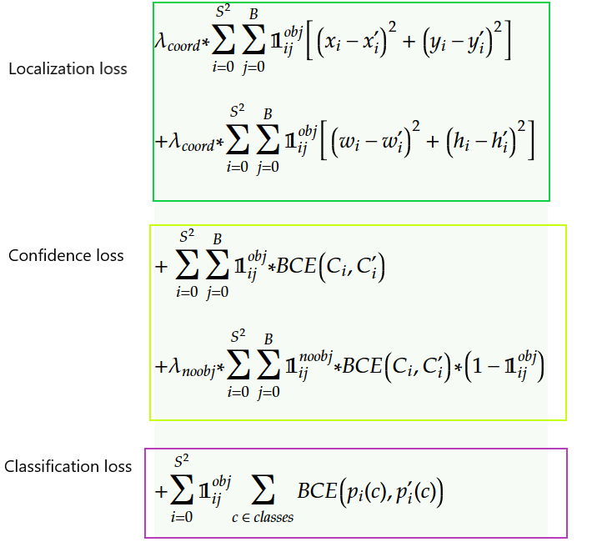
Loss Function
YOLOv3 Loss Function improvements -
Class Prediction
YOLOv3 replaces the softmax function with independent logistic classifiers to calculate the likeliness of the input belongs to a specific label.
Bounding box prediction & cost function calculation
If the bounding box prior (anchor) overlaps a ground truth object more than others, the corresponding objectness score should be 1.
For other priors with overlap greater than a predefined threshold (default 0.5), they incur no cost.
If a bounding box prior is not assigned, it incurs no classification and localization lost, just confidence loss on objectness.
5

Slide 28
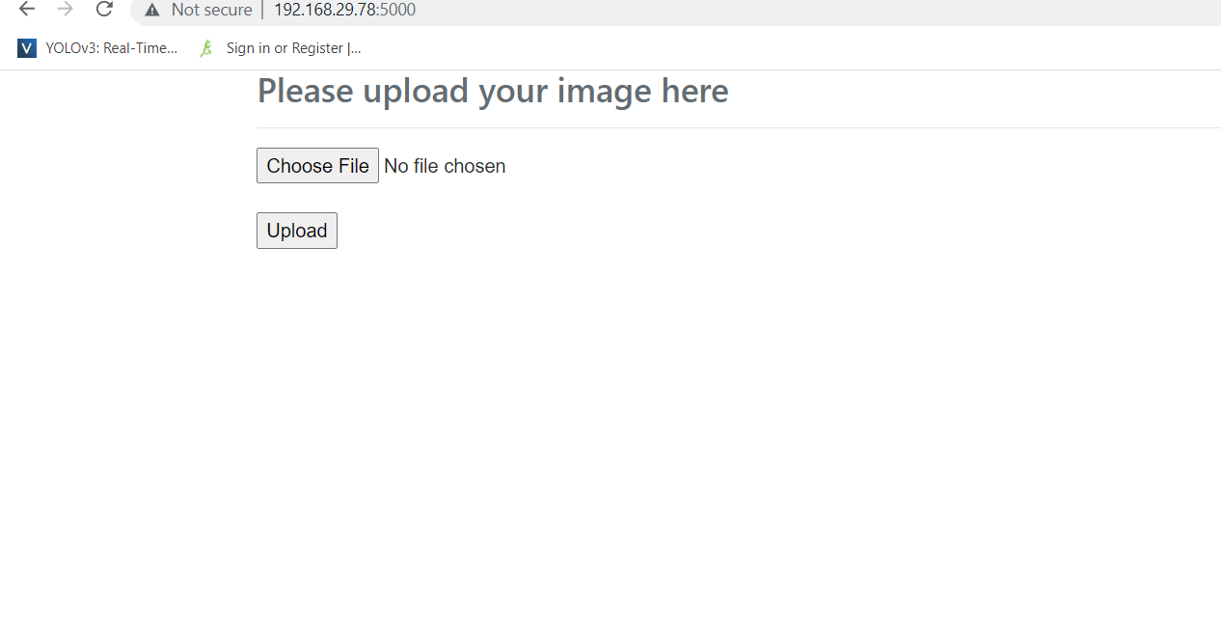
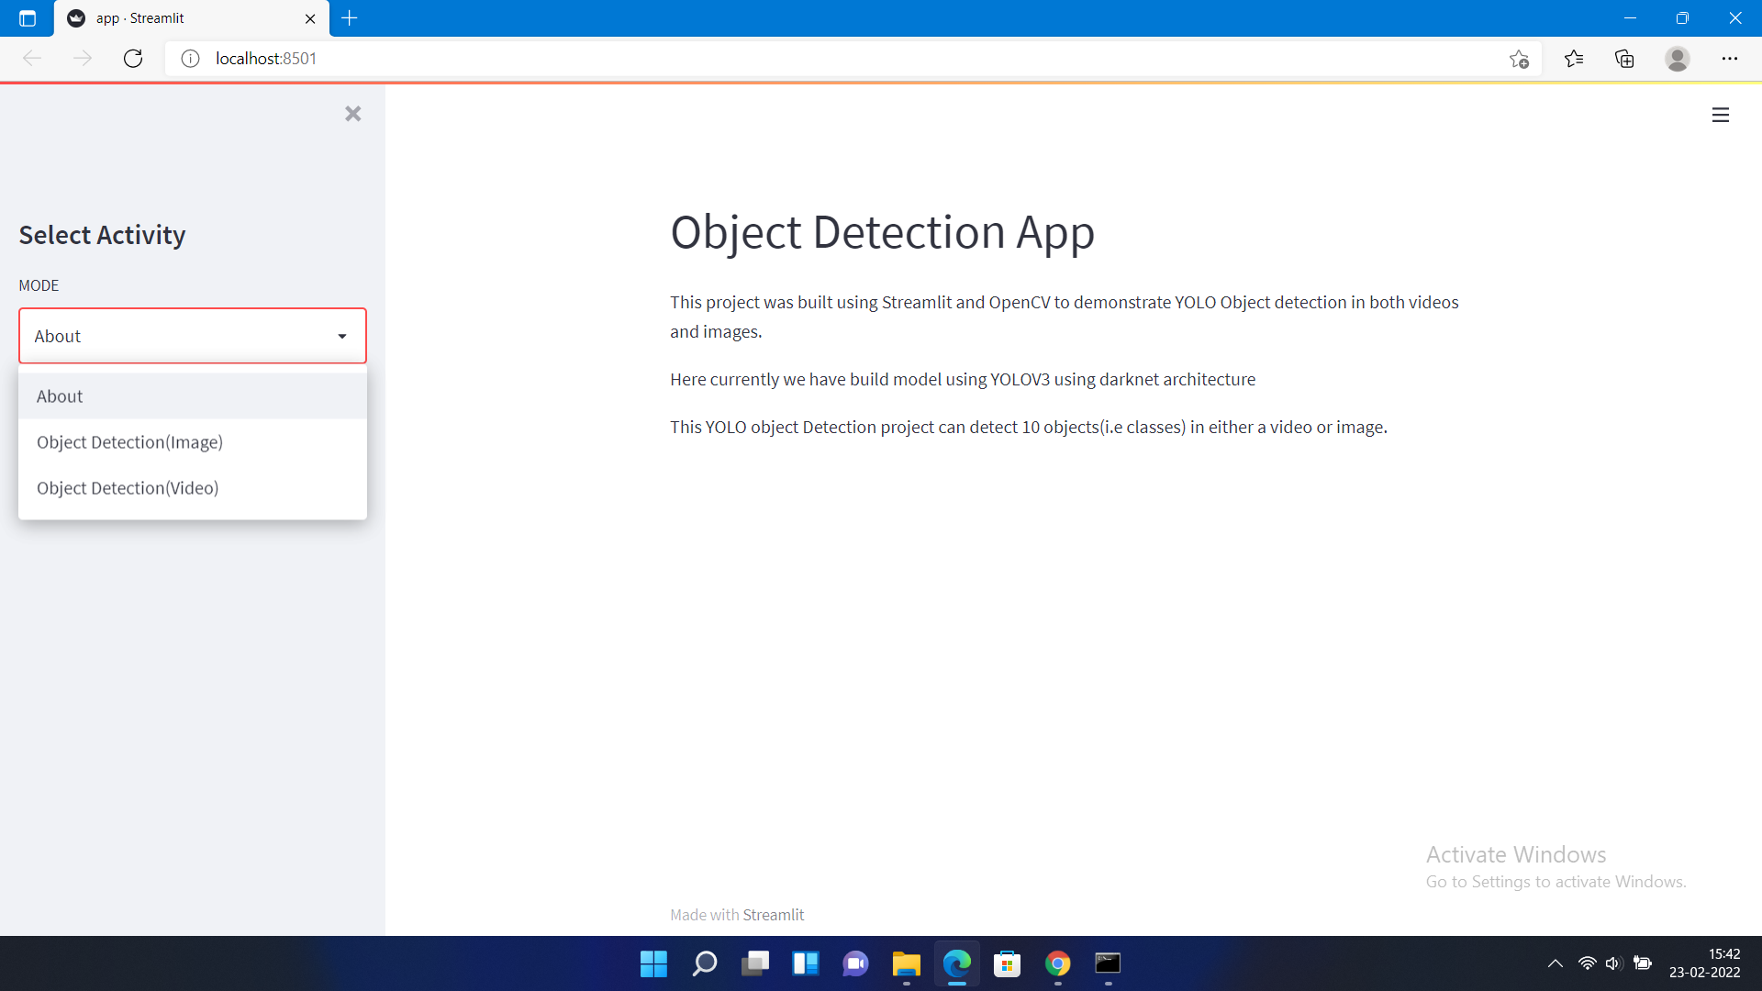
Model Deployment
Different methods can be used for model deployment on PROD SYSTEM.
1. Flask 2. Streamlit 3. FastAPI 4.PyQt 5. Cloud deployment
Flask
Streamlit
5

Slide 29
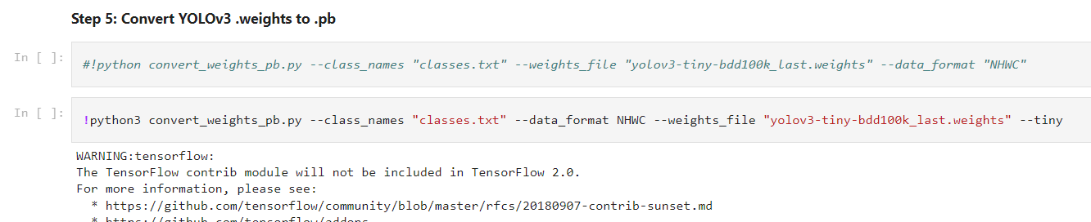
Flask Deployment
Prerequisites for deploying the model using Flask -
training weights file should be in protobuf format.
Convert weights file into frozen file(.pb) and then generate tflite file using TensorflowLite.
Weights file can be converted into Tensorflow lite file as mentioned above:
1) Gather all required files used / generated from your YOLO model like -
classes.txt
yolo.weights file
2) Create a folder named YOLOv3_TFLite and upload / move / copy the files.
3) Upload / mount the YOLOv3_TFLite folder into google drive
4) After collecting all the required files run the below command to convert into frozen(.pb) file
5) 5) Convert .pb file into tensorflow lite file(This step can be skipped as frozen file is enough for our flask deployment)

Slide 30
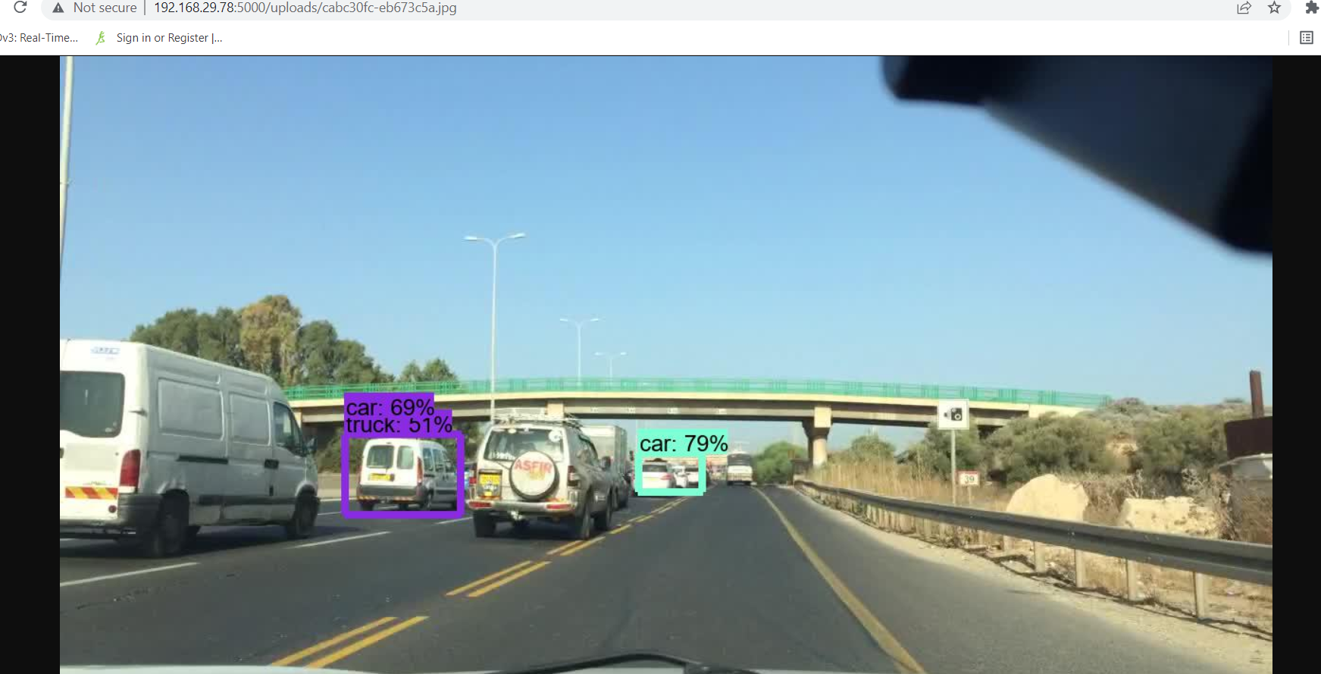
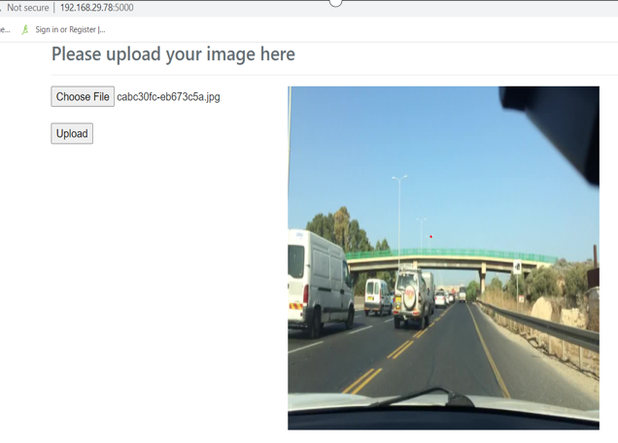
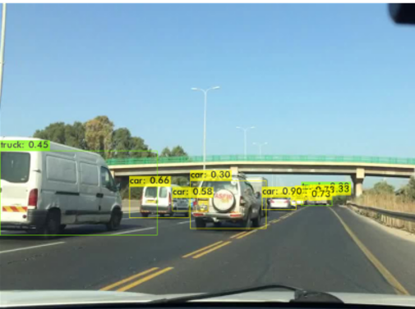
Challenges & Observations
Objects detection is not much efficient as dimensions are changing during conversion of weights file to tflite file
It doesnt support multi requests, server becomes slow and time consuming for detecting single image.
Difficulty in video detection
Flask detection
darknet detection

Slide 31
Streamlit Deployment
No need of weights file conversion into protobuf / TFLite file
1) Gather all required YOLO Files
yolo config file(.cfg)
yolo weights file(.weights)
yolo classes file(.names or .txt)
2) Create deployment model using darknet model function(readNetFromDarknet) used to detect objects using our custom training YOLO Files
3) Run the command - streamlit run app.py to run the app in local machine for the demo.
Issues :
1. Invalid index or scalar variable error

Slide 32
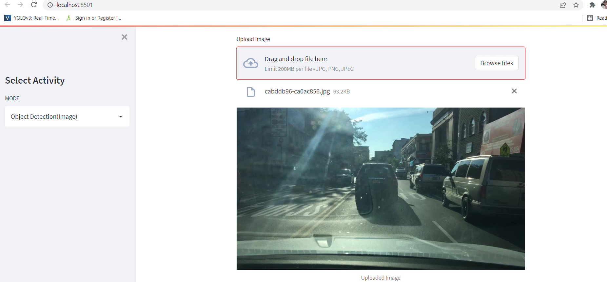
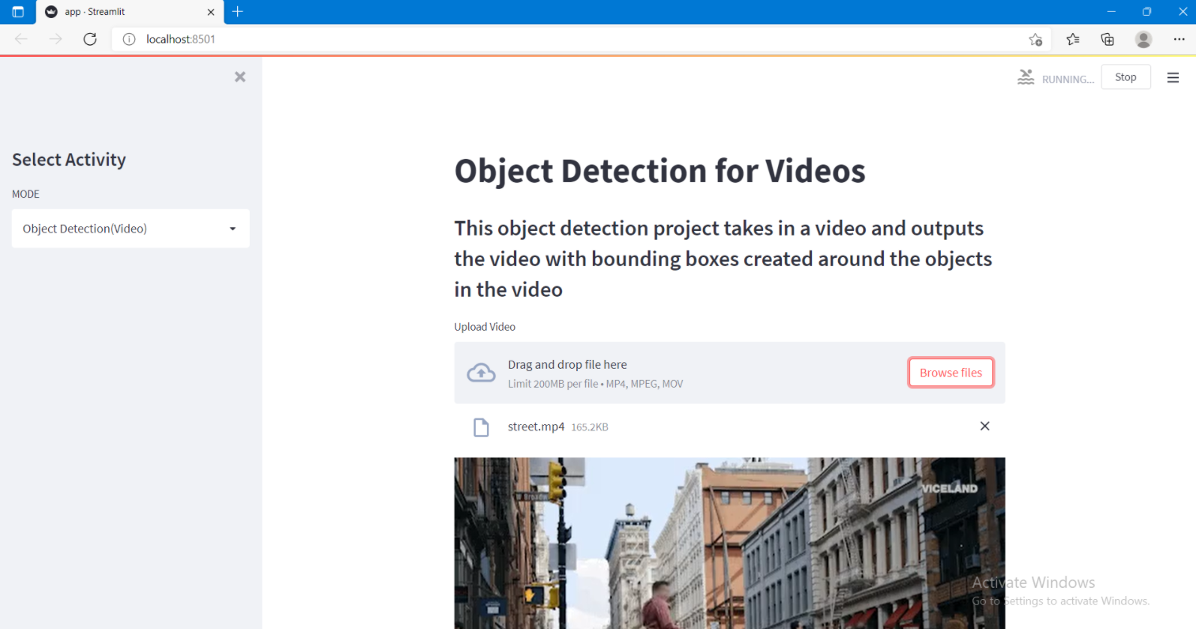
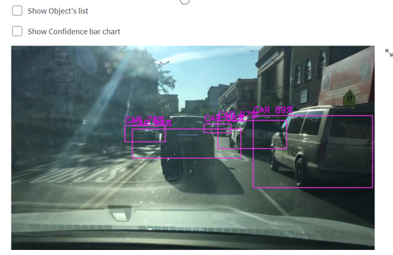
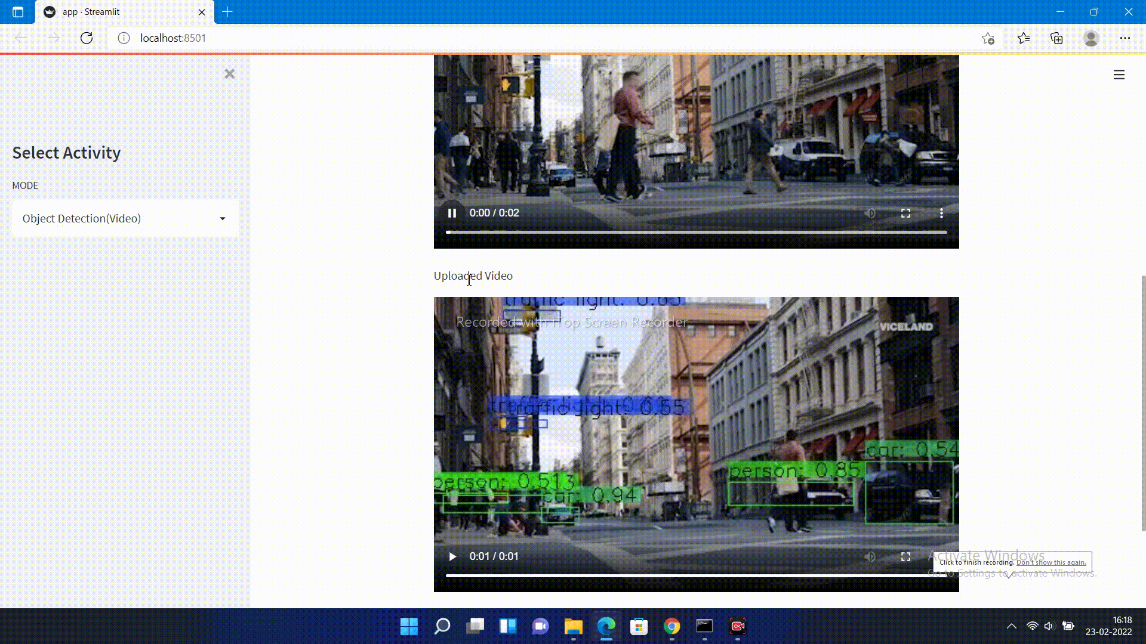
Streamlit Deployment Output / Prediction

Slide 33
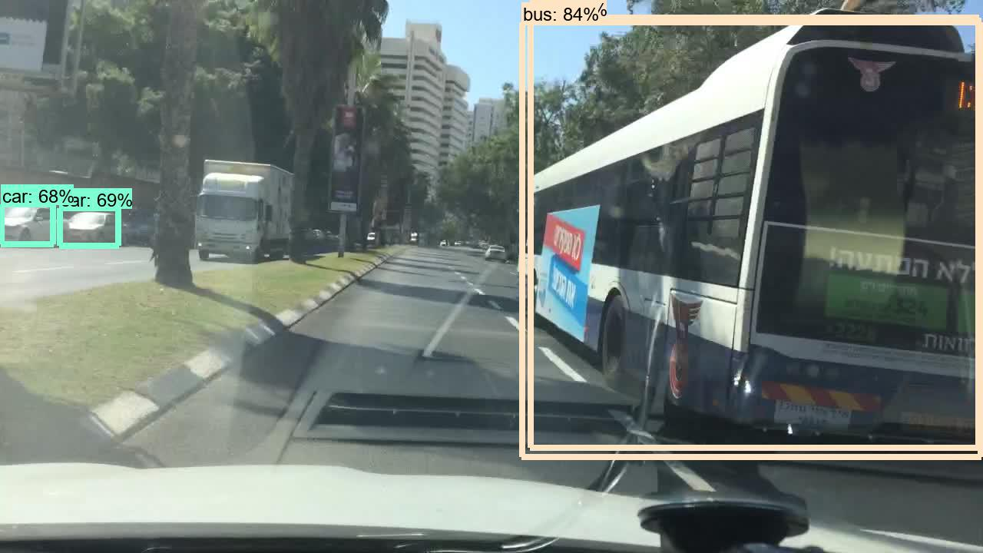
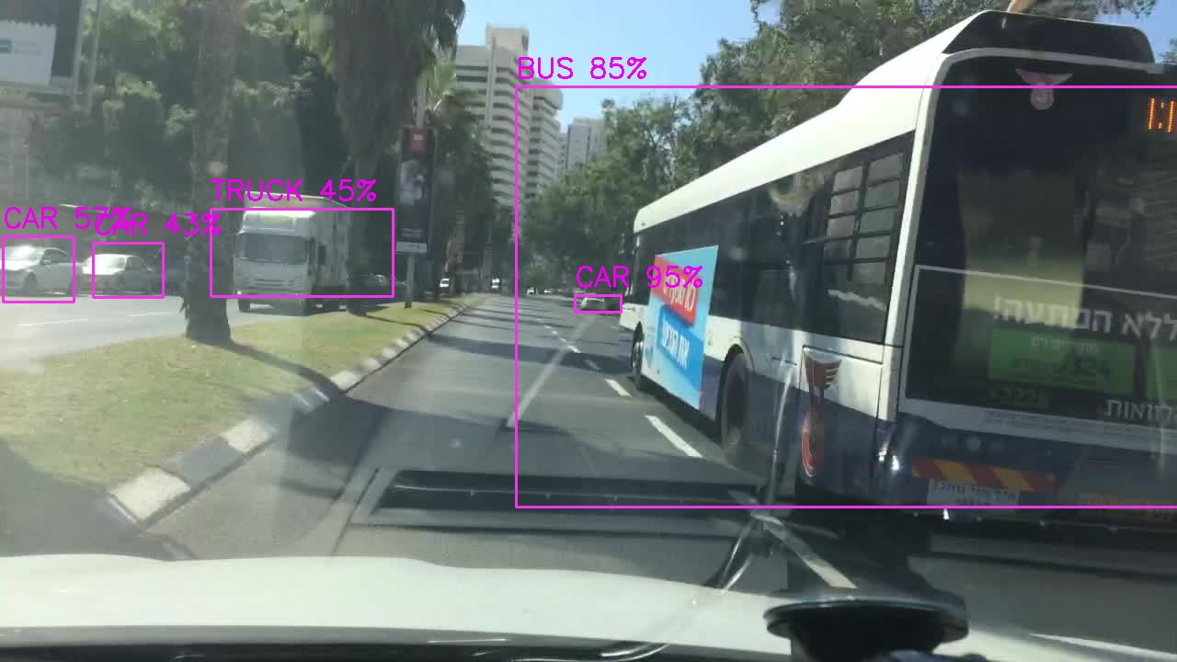
Flask VS Streamlit Detection Observation

Slide 34
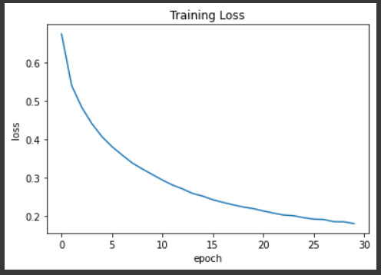
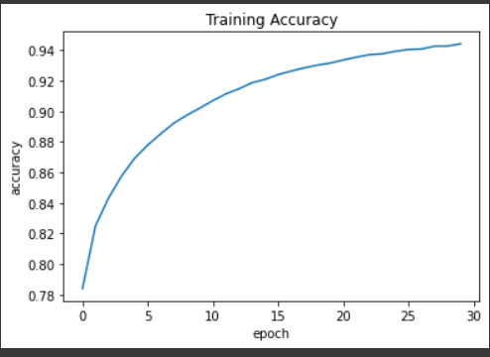
Future Work - Image Segmentation
Human parsing is the task of segmenting a human image into different fine-grained semantic parts such as head, torso, arms and legs.
Referring the research paper - https://arxiv.org/abs/1802.02611
Spatial pyramid pooling module or encode-decoder structure are used in deep neural networks for semantic segmentation task.
Specifically, our proposed model, DeepLabv3+, extends DeepLabv3 by adding a simple yet effective decoder module to refine the segmentation results especially along object boundaries.
Trained the DeeplabV3Plus for semantic segmentation

Slide 35
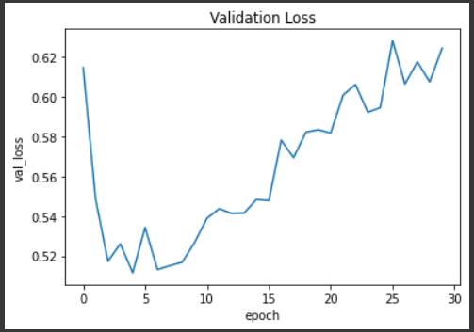
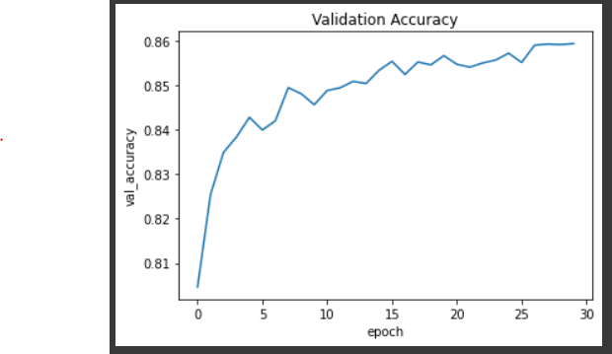
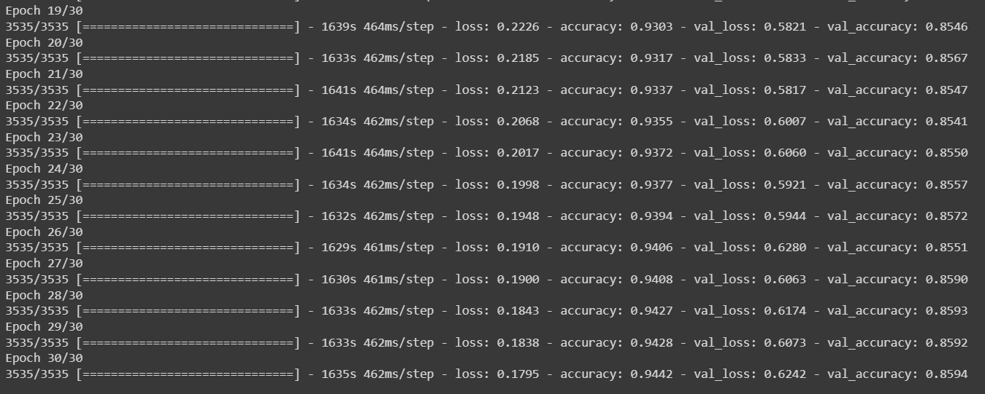
Future Work - Image Segmentation
Validaion Loss and Acuracy

Slide 36
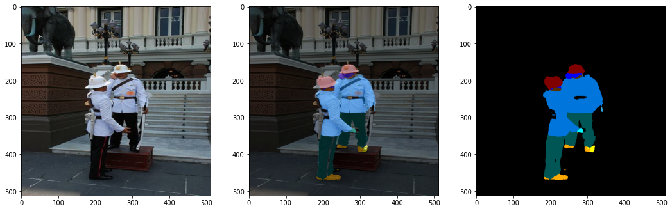
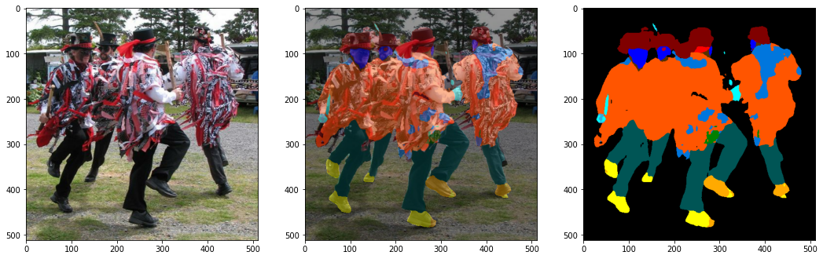
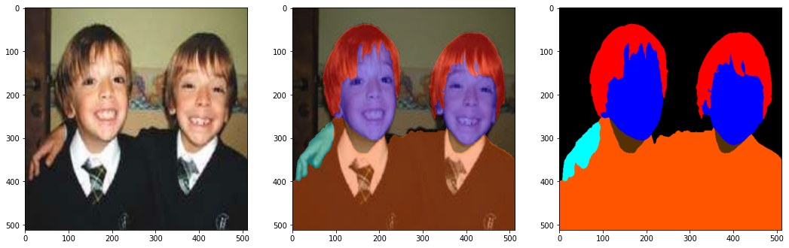
Future Work - Image Segmentation - Training Predictions

Slide 37
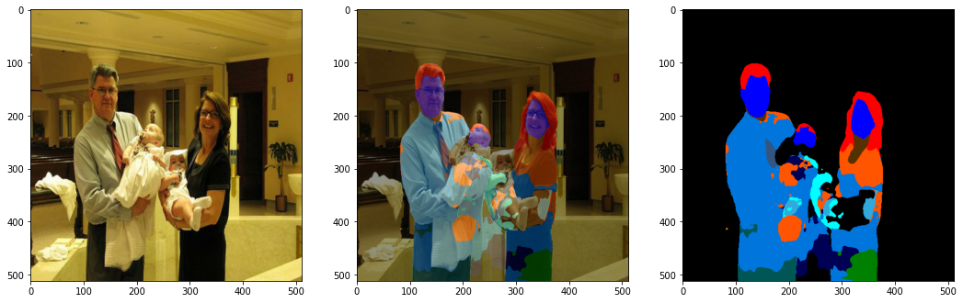
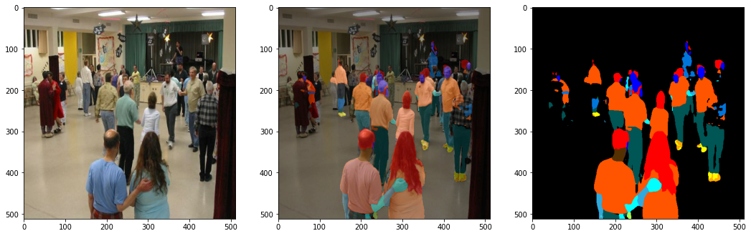
Future Work - Image Segmentation - Testing Predictions

Slide 38
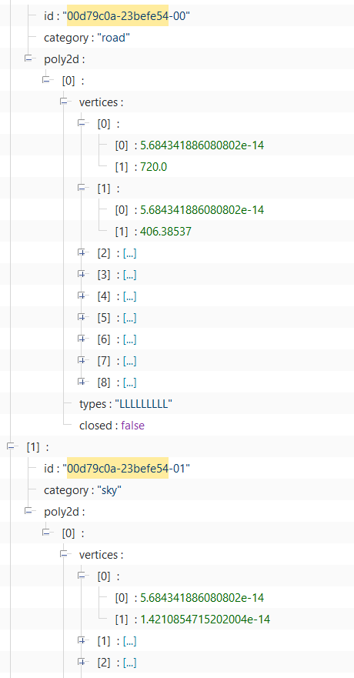
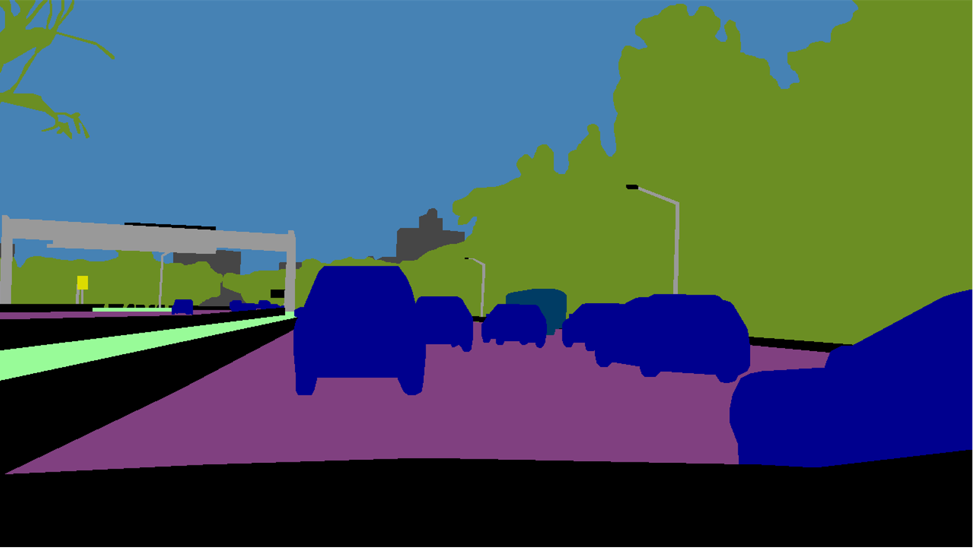
Image Segmentation - BDD10K Dataset
Analysing the BDD10K dataset for preprocessing is in progress.

